Slide 1
Natural Cold Water District Cooling Plants Enabled by Directional Drilling
Ted Jagusztyn
Innovator
Cotherm of America Corp
Fort Lauderdale, Florida
13 October 2010

Slide 2
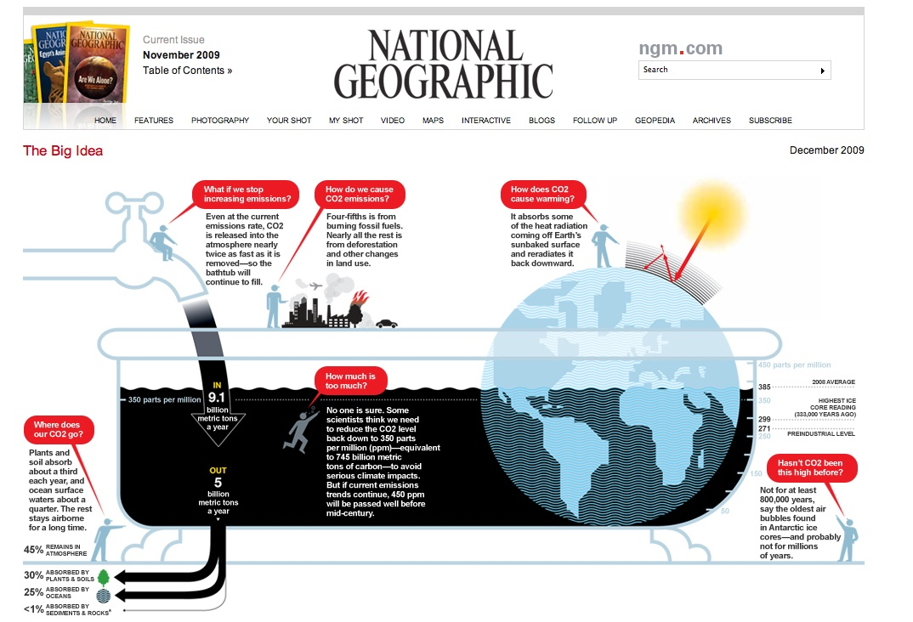
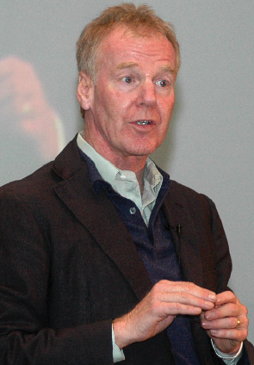

Today’s Global Challenge
Dr. Peter Senge ~ M I T
Notes:
Peter Senge – Introduce Bathtub - 4 billion tons of excess CO2 every year

Slide 3

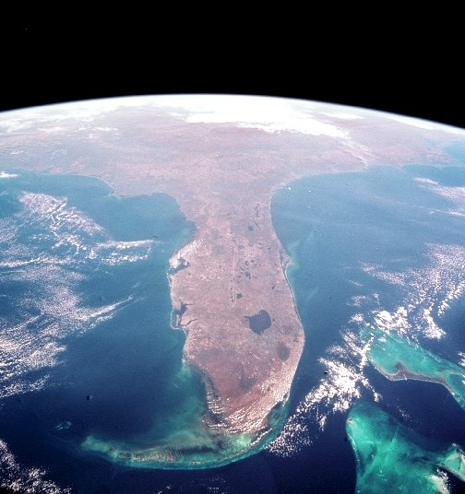
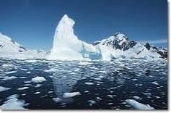
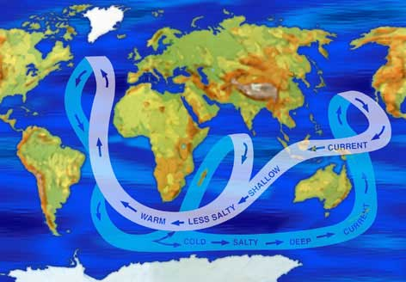
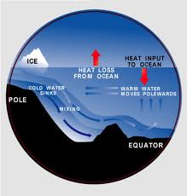
Road to Climate Friendly Air Conditioning
Hydrothermal
Cooling
Notes:
Introduce Hydrothermal cooling and Directional Drilling and relate to Florida with the Gulf Stream inducing cold water close to shore.

Slide 4
Integrating Technologies
+
Hydrothermal
Cooling
Directional
Drilling
A mature drilling technique used in petroleum extraction and in civil construction
Enables drilling under the sea bottom to access water
Currently can reach a horizontal displacement of 11km and depths exceeding 1000 meters

Slide 5
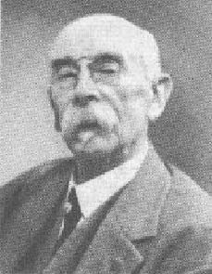
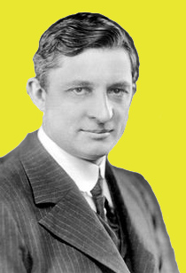
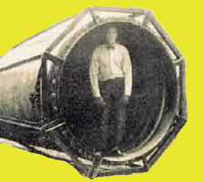
Progress of Cooling and Ocean Thermal Energy
1881 ~ Jacques-Arsene d’Arsonval
1902 ~ Willis Carrier
1930 ~ Georges Claude
Notes:
Introduce “Ideas Men” of Cooling and Ocean Thermal EnerGy

Slide 6
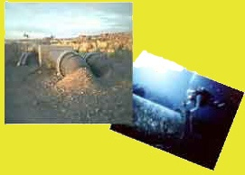
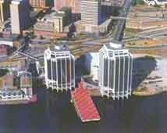
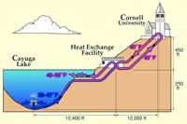
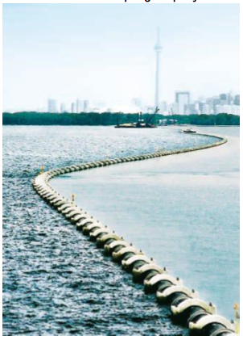
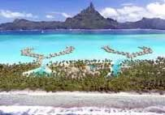
Existing Applications of Hydrothermal Cooling
I. Natural Energy Laboratory of Hawaii (NELHA)
II. Purdy’s Wharf Complex ~ Halifax Nova Scotia (1979)
Submerged piping at 45ft and 2000ft
to air condition facility & OTEC Research
III. Cornell University
Cooled a small office complex
from adjacent cold seawater
IV. InterContinental ~ Bora Bora, Polynesia
Provides roughly 18,00- 20,000 tons of cooling
Uses 86% less electricity
V. Enwave District Cooling ~ Toronto, Canada
Entire facility cooled by deep seawater
Proving 90% savings over electric
chilled water system
Lake source cooling system
from neighboring Lake Ontario
Provides 59,000 tons of cooling
Cold water is dual purposed as pure drinking water
Notes:
Introduce The Five Existing Hydrothermal Cooling Applications

Slide 7
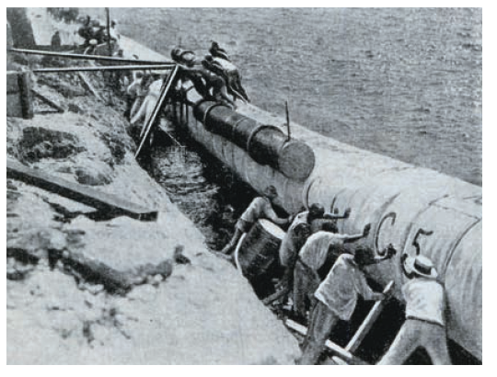
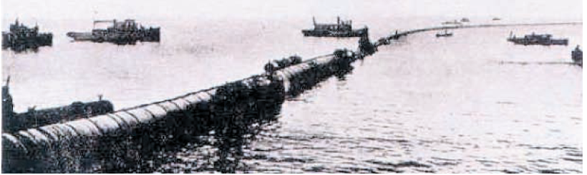
Challenges of Laying Pipes in the Ocean
1929/30 ~ Georges Claude Matanzas Bay
Mishaps sunk the pipe three times
Notes:
Tell of the Cuba Ocean Thermal Pipe Disasters

Slide 8
Challenges of Laying Pipes in the Ocean
Natural Energy Laboratory of Hawaii (NELHA)
After 2006 Earthquake – warmer water from deep pipe
Notes:
<Mention the pipe damage at Hawaii NELHA

Slide 9
Challenges of Laying Pipes in the Ocean
Toronto Enwave Lake Source Cooling Plant
Sudden wind during installation causes concern
Notes:
Mention the sudden wind increase during the critical submergence of the Toronto pipe

Slide 10
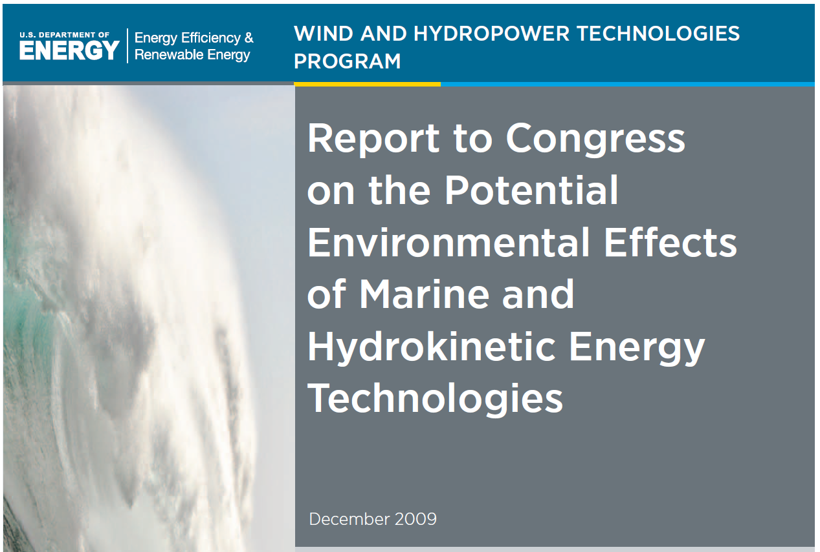
Challenges of Laying Pipes in the Ocean
Avoiding destruction of Marine life at the sea bottom
Notes:
US DoE advises caution and adaptive management when laying cable on the marine bed – HDD recommended

Slide 11
Directional Drilling
Notes:
Play video to introduce audience to directional drilling in practice

Slide 12
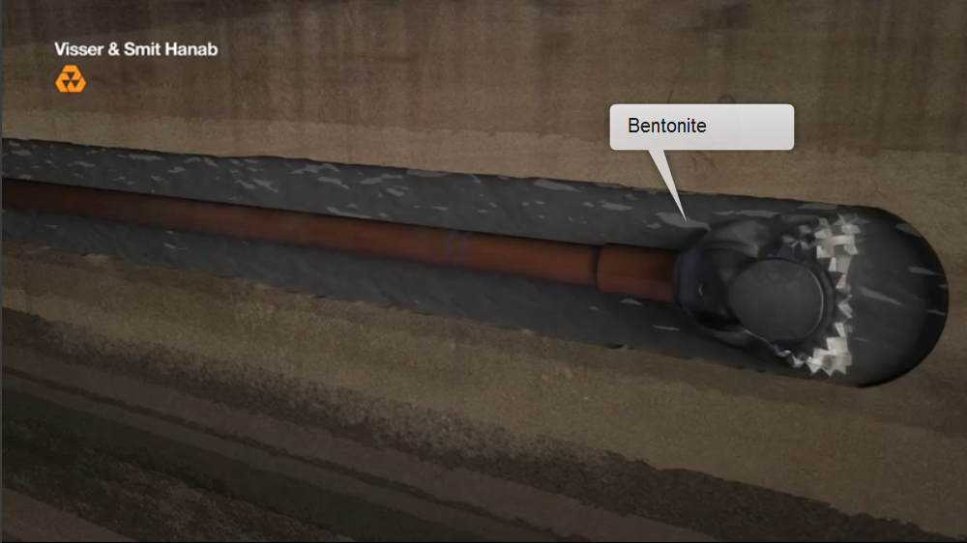
Directional Drilling
Notes:
Play video to introduce audience to directional drilling in practice

Slide 13
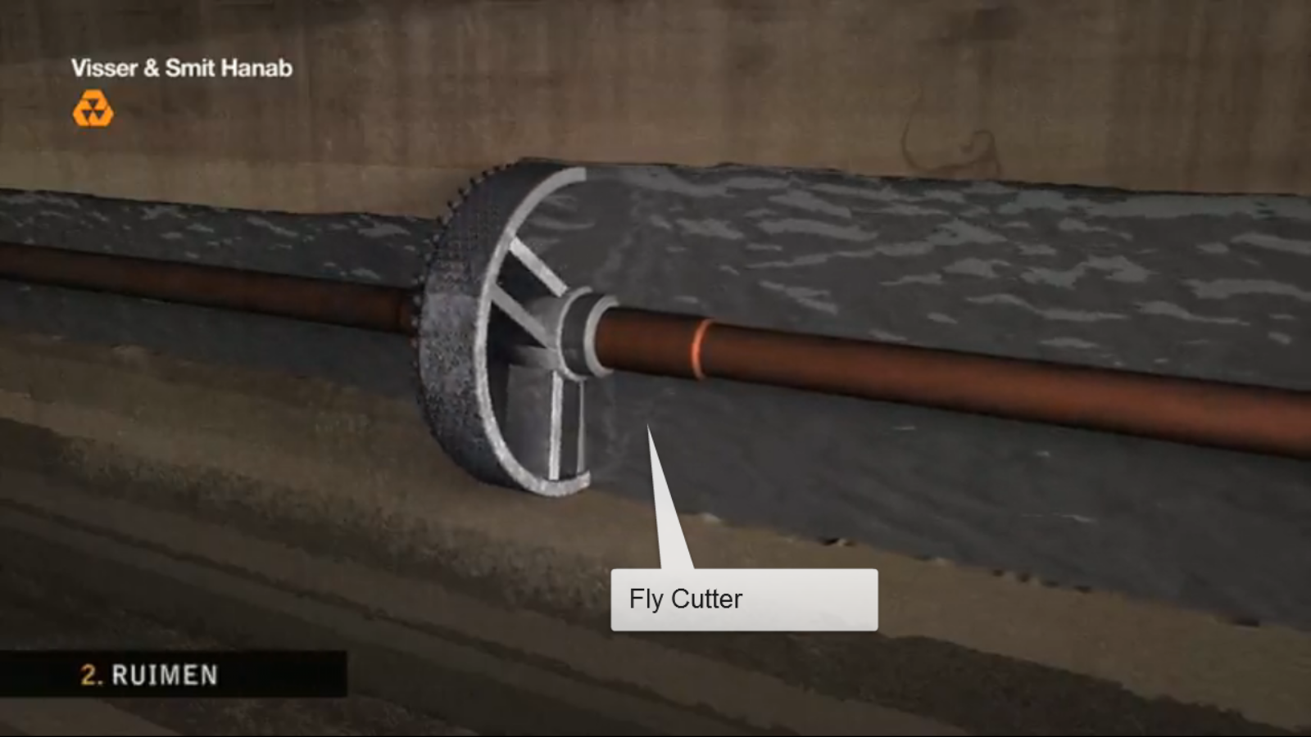
Directional Drilling
Notes:
Play video to introduce audience to directional drilling in practice

Slide 14
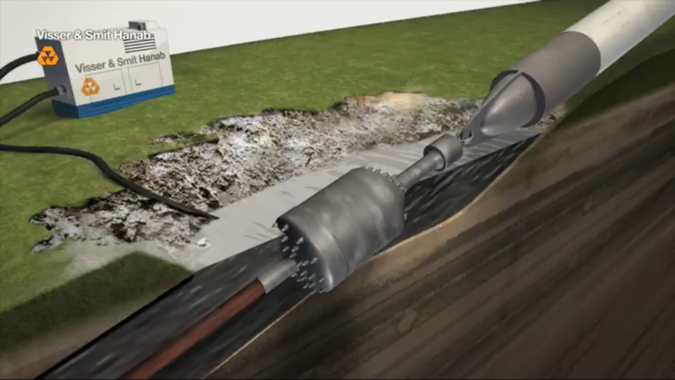
Directional Drilling
Notes:
Play video to introduce audience to directional drilling in practice

Slide 15
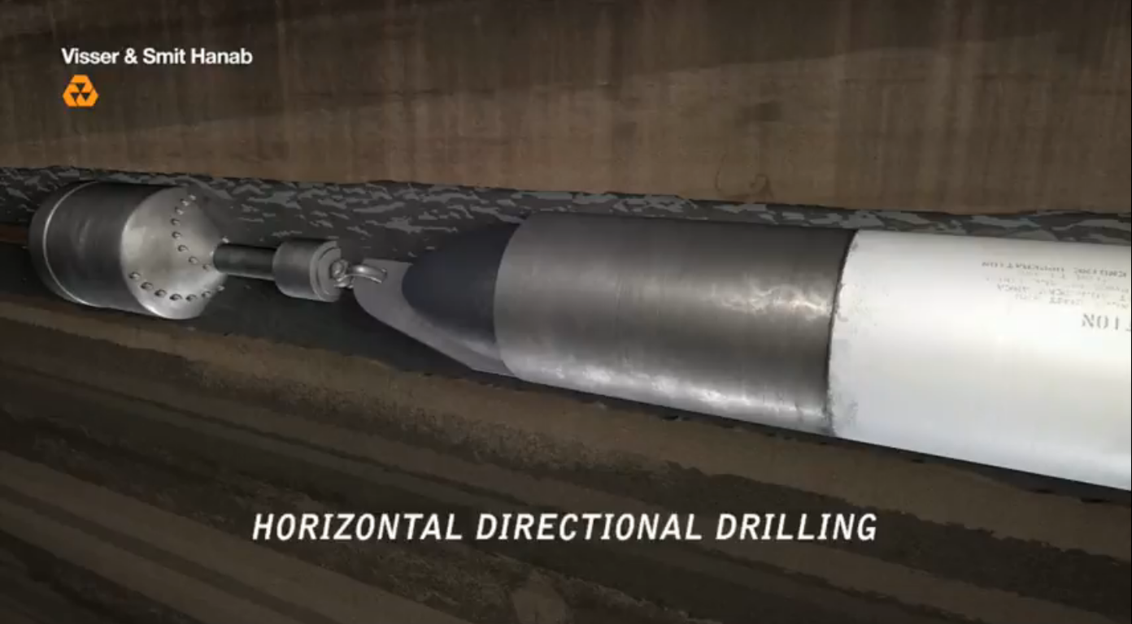
Directional Drilling
Notes:
Play video to introduce audience to directional drilling in practice

Slide 16
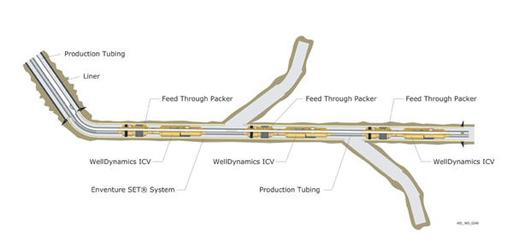
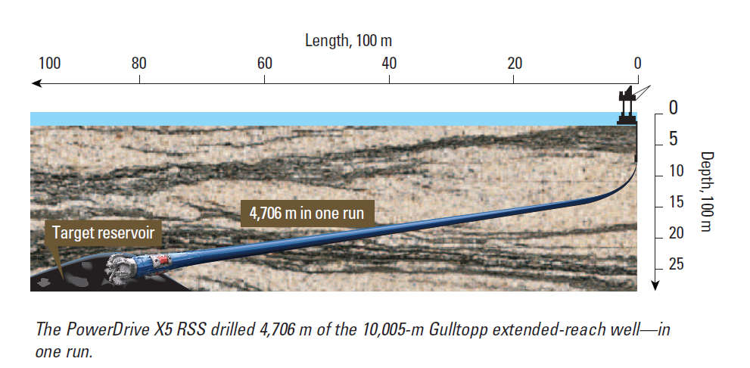
Progress of Directional Drilling
Texon, Texas USA (1929)
First attempt of horizontal well to access gas and oil reservoirs.
Martin Cherrington (1963)
Used directional drilling in the civil construction industry
Factors Influencing Change From Vertical to Horizontal:
  Commercial
    Multilateral
  Technical Superiority
    Measure while drilling
    Rotary Steerable Drilling Equipment
Notes:
Show the progress of horizontal directional drilling

Slide 17
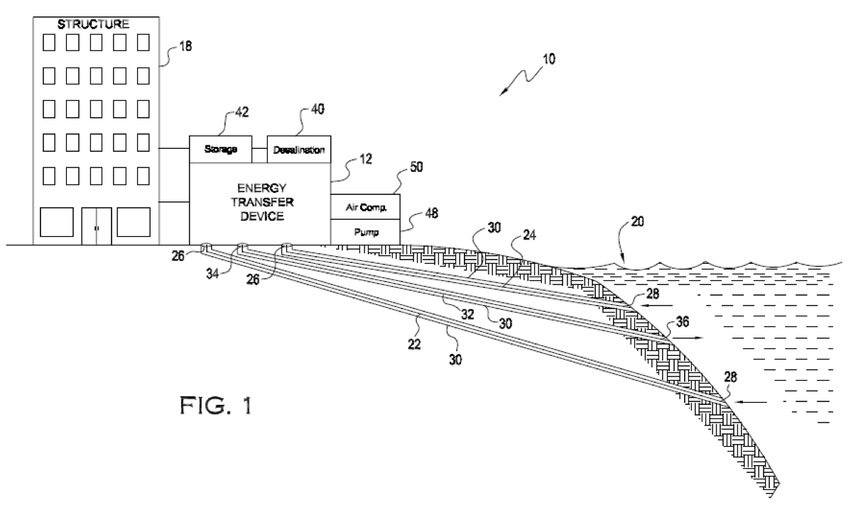
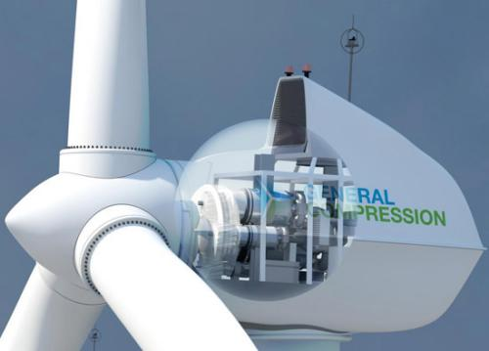
Drilled Hydrothermal Cooling D H C
Drilled Hydrothermal Energy D H E
Integrating Hydrothermal Cooling
And Directional Drilling
Robust
implementation
2. Protected
investment
3. Environmentally
responsible
4. Sustainable
integrations
Hydrothermal
Cooling
Directional
Drilling
~ Airlift Wind Compressors ~
For sustainable water pumping
Warm Surface Water Intake
Cold Deep Water Intake
Return Water
Protected Seawater Conduits
Notes:
Introduce the innovation of integrating directional drilling and hydrothermal energy

Slide 18
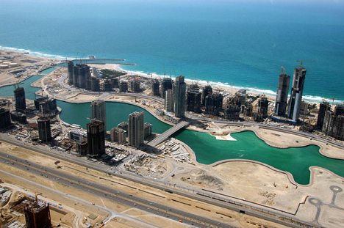
Drilled Hydrothermal Cooling D H C
Benefits
Mechanical
District Cooling Plant
23,000 tons
0.83 Ikw/ton
$0.12 per Kwh
8760 operating hours per year 50% load
Estimated Operating cost per year $10. 03 million
Drilled
Hydrothermal Cooling Plant
23,000 tons
0.10 Ikw/ton
$0.12 per Kwh
8760 operating hours per year 50 % load
Estimated Operating cost per year $1. 20 million
Estimated Savings per year with DHC
$8,825,000
Notes:
Give an example of the savings of a DHC plant versus a conventional mechanical district cooling plant

Slide 19
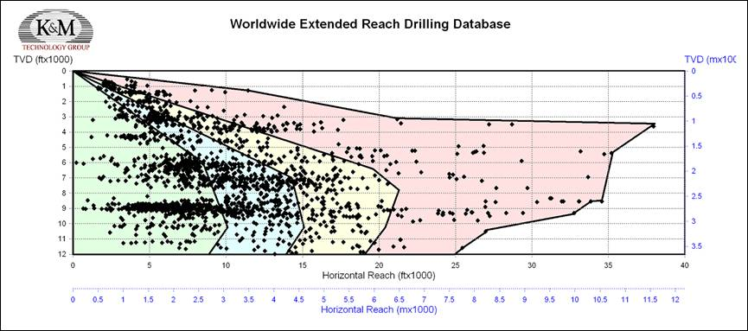
Drilled Hydrothermal Cooling D H C
Drilling Cost
The cost of drilling a horizontal well
“The 1993 Joint Association Survey of drilling costs on 845 horizontal wells $80.76/ft
According to Tim Boulay, Senior Drilling Engineer of the K&M Technology Group, “Costs of ERD wells can vary greatly, anywhere from $3-4million up to well over $150 million. Contributing factors are overall complexity, location, geology, formation pressures, onshore or offshore, water depth, rig requirements, and industry economics”
Sweet Spot for DHC – 1000 meters depth under 3000 meters step out
Notes:
Mention the drilling cost examples – stress the need for diligent feasibility studies beforehand – Show the “sweet spots” for drilling

Slide 20
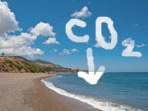
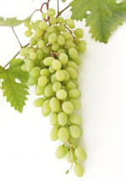
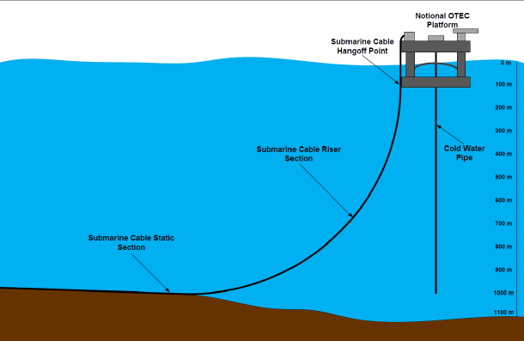
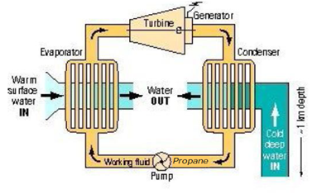
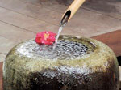

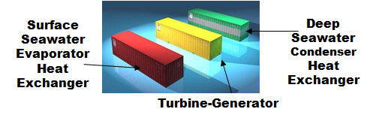
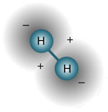
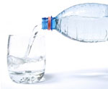
Auxillary Benefits
Hydrothermal
Cooling
90% saving over
Mechanical
cooling
Increased
CO₂ Absorbtion
Agriculture &
Mari-Culture
Enriched
Mineral
Water
Coordination
With Offshore
OTEC Plant
Drilled
Hydrothermal
Energy
Waste
Water
Treatment
Power
Generation
Fuel Production
Water Desalination
Notes:
Mention eight other benefits besides Drilled Hydro Thermal Cooling which constitute to the revenue and environmental enhancement of Drilled Hydrothermal Energy

Slide 21
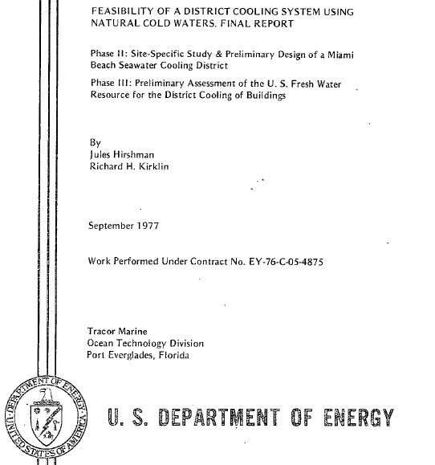
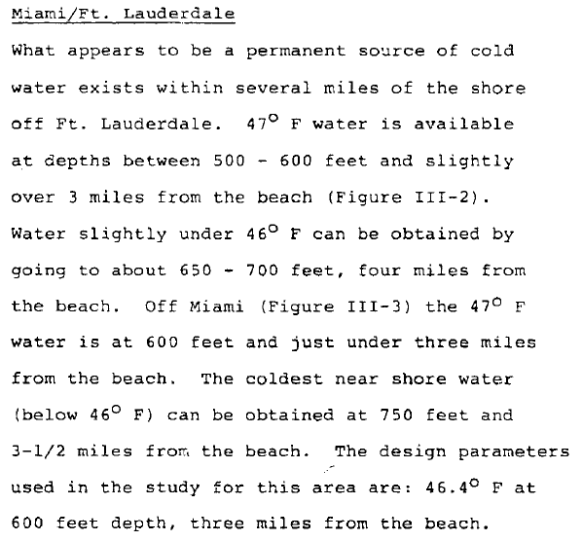
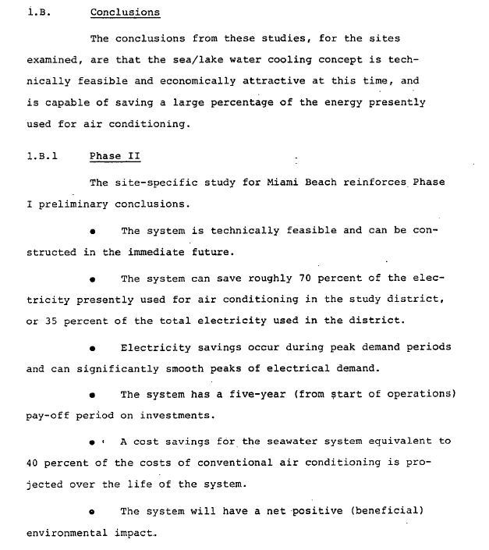
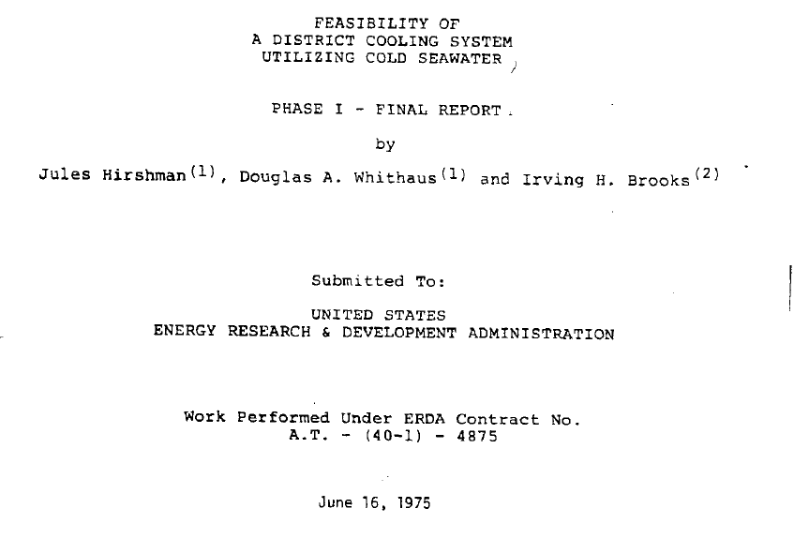
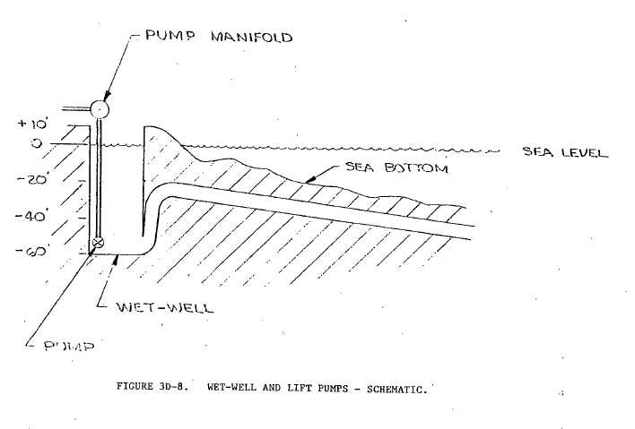
Potential Drilled Hydrothermal Energy Application Areas
* Miami, Fort Lauderdale

Slide 22
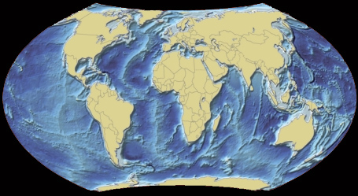
Next Steps
Identify potential locations with cold water
Identify & quantify the needs
Hire an assessment team
Establish feasibility
Design funding and business model
Pilot testing
Execute project
Execute benefits
Hydrothermal
Cooling
Increased
CO₂ Absorbtion
Agriculture &
Mari-Culture
“The best way to
predict the future,
is to invent it.”
~ Alan Kay
Enriched
Mineral
Water
Coordination
With Offshore
OTEC Plant
Drilled
Hydrothermal
Energy
Waste
Water
Treatment
Power
Generation
Fuel Production
Water Desalination

Slide 23
Today’s Global Challenge
“We can’t solve problems by using the same kind of thinking we used when we created them.”
~ Albert Einstein
Thank You
Notes:
Optional slide at the end quoting Einstein’s suggested approach applied to today’s Global challenge

